Slide 1
DB
VIEWS

Slide 2

OBJECTIVES FOR TODAY
VIEWS
https://www.w3schools.com/sql/sql_view.asp
https://www.datacamp.com/community/tutorials/views-in-sql

Slide 3

The following SQL selects all customers from Brazil:
SELECT CustomerName
FROM Customers
WHERE Country = "Brazil";
Customer

Slide 4
The following SQL creates a view that selects all customers from Brazil:
CREATE VIEW BrazilCustomers AS
SELECT CustomerName
FROM Customers
WHERE Country = "Brazil";
Customer
BrazilCustomers
Virtual table

Slide 5
We can then query the view as follows:
SELECT * FROM [BrazilCustomers]
WHERE BrazilCustomers.CustomerName == ‘ronan" ;
BrazilCustomers

Slide 6
What is a view ?
A view is a virtual table based on the result of an SQL statement.
View name
CREATE VIEW ViewName AS select statement
Create query to select data from database

Slide 7
What is a view ?
You can select data from multiple tables
It does not hold the data
it holds only the definition of the view
It is computed dynamically, whenever the user performs any query on it.

Slide 8
Why do we need to create views ?
Simplify the complex SQL queries.
Provide restriction to users from accessing sensitive data.
For example, a user has permission to access particular columns of data rather than the whole table.

Slide 9
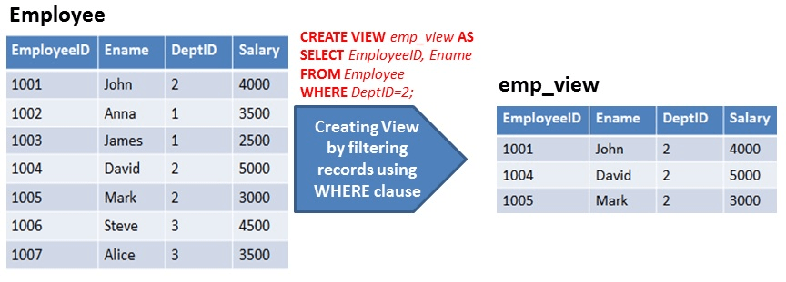
Example of views

Slide 10
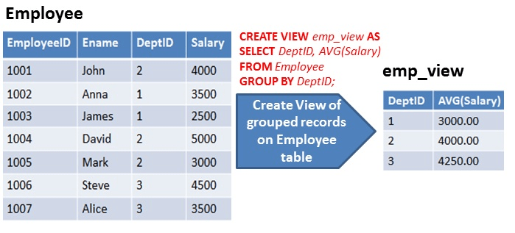
Example of views

Slide 11
Operations on VIEWS
CREATE
REMOVE
CREATE VIEW viewName AS
SELECT *
FROM Customers
DROP VIEW viewName

Slide 12


Good and bad points on view
Hide the complexity
Can take time to compute
Allow to protect some data
Can create dependencies

Slide 13
EXERCICES !

